Slide 1
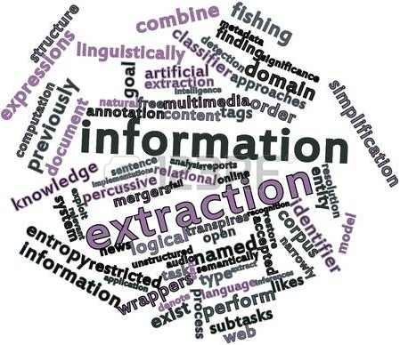
NLP Applications Area Investigations: Information Extraction
Name- Sanjana Kiran
SUID- 310810952

Slide 2



What is Information Extraction?
Information Extraction is the task to find and understand the limited relevant parts of texts, to extract structured representation of relevant information from the unstructured or semi-structured machine-readable documents.
Goals:
1.Organize information so that it is useful to people
2. Put information in a semantically precise form that allows further inferences to be made by computer algorithms
Common Tasks:
1. Named Entity Extraction - retrieval of what are typically proper nouns - "who", "where"; (Organisations, people, Locations, product names)
2. Relationships Extraction – identification of relations between entities - what company bought what other company? what gene is regulating this other gene?
3. Opinion extraction or sentiment extraction- Determine the positive or the negative tonality of the text when describing a product, a service, or a person

Slide 3
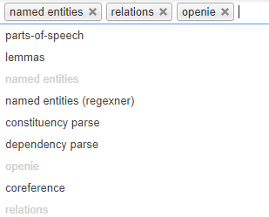
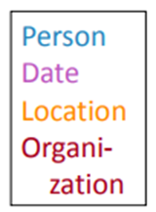
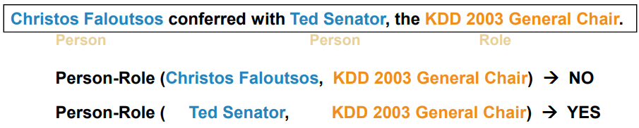
Stanford Information Extraction:
Stanford Open Information Extraction(openIE):
To extract named entities, binary relations and more from the plain text. The schema for these relations does not need to be specified in advance. This software is a Java implementation of an open IE system.
Named Entity Recognition
To find and classify the names in the text. Person, Date, Location, Organization.
3 standard approaches-
Hand written Regular Expression 2. Using classifiers 3. Sequence models
Association/Relation Extraction
Checking if groupings of entities are instances of a relation.
2 standard approaches
Manually engineered rules- Rules defined over words/entities and parsed text
Machine Learning Based- Learn relation classifier from example, Bootstrap rules/patterns from seed example.
Pros
Named entities can indexed, linked off
A lot of IE relations are associations between named entities.
For question answering, answers are often named entities
Cons
IE is hard on web- Many web pages tag various entities with links to topic pages, etc.
Annotations provided for IE by openIE
NER
Binary Relation Association

Slide 4

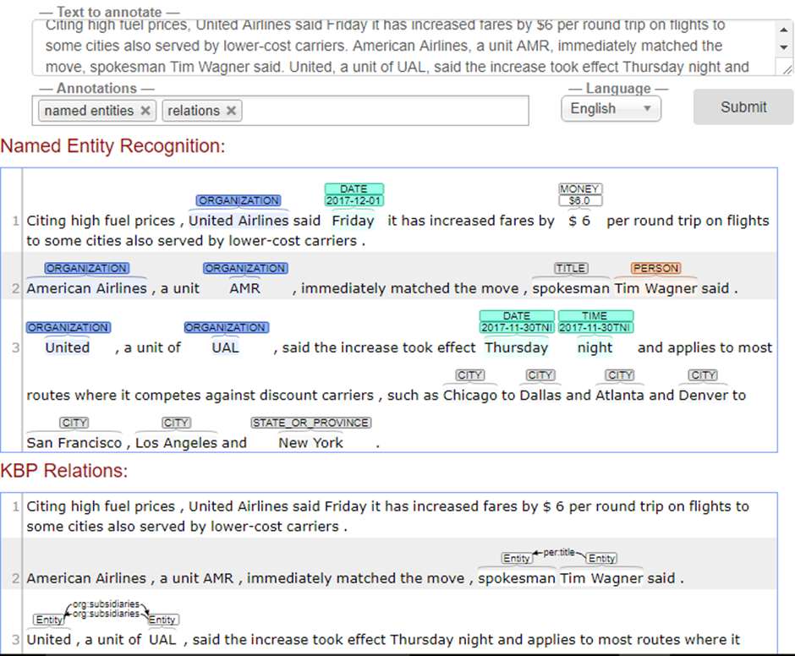
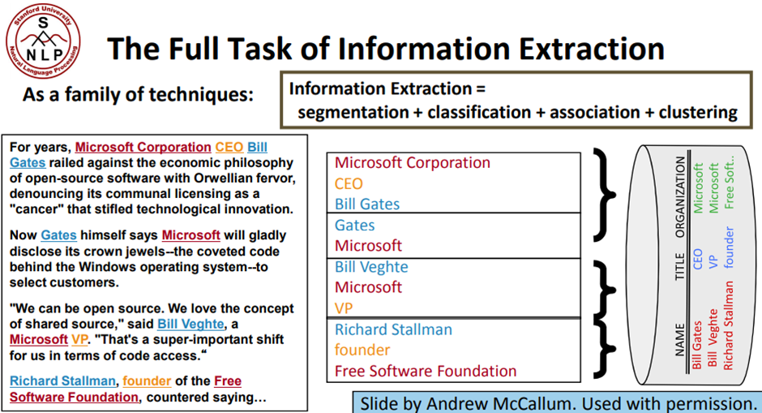
Stanford Information Extraction-
Link to run the Stanford Open Information Extraction- http://corenlp.run/
Example of Full task Information extraction based on NER.

Slide 5
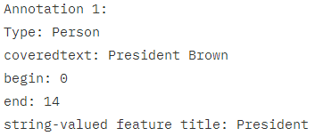
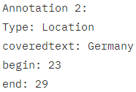
IBM Information Extraction
IBM, Watson uses Natural Language Processing for advanced text analysis
Supported Tasks for IE:
Named entity recognition-Recognition of entity.
References- Identification chains of noun phrases that refer to the same object
Terminology extraction- Finding the relevant terms for a given corpus
Opinion or sentiment extraction
There are many different algorithms to implement subtasks of information extraction.
Rule-based algorithms-uses patterns to extract concepts like phone numbers or email-addresses, SSN etc
List-based algorithms- uses an enumeration of words to extract concepts like person names, product names, or location names.
More advanced algorithms use natural language processing, machine learning, statistical approaches, or a combination of these to extract complex concepts like sentiment or tonality
IBM InfoSphere Warehouse design studio provides rule based algorithms and list based algorithms for IE
(The software components that implement IE are called annotators)
Example mentioned in IBM knowledge center- President Brown visited Germany

Slide 6


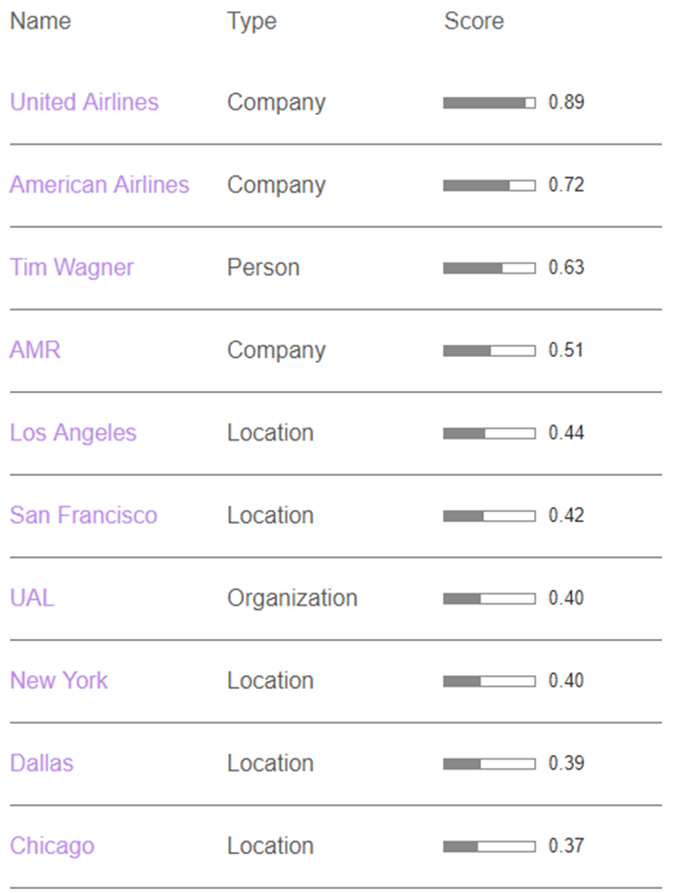
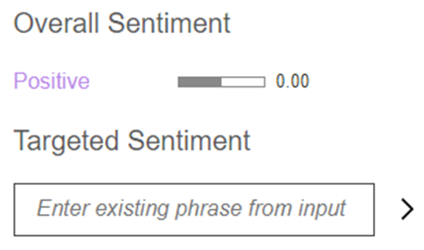
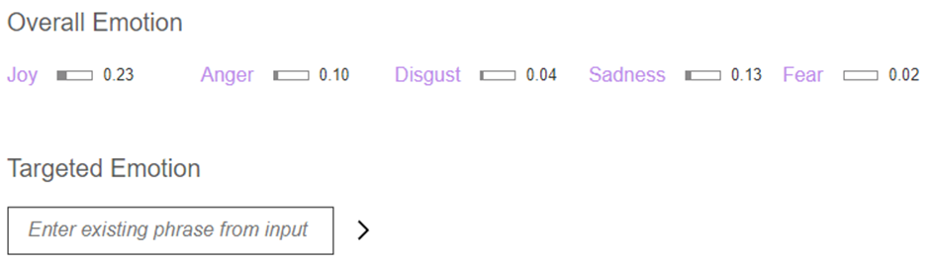
IBM Information Extraction
IBM Watson Text analysis demo- https://natural-language-understanding-demo.ng.bluemix.net/
IBM Natural Language Understanding is collection of API’s that offer text analysis to understand sentiment, emotion, keywords, entities, categories, concept, semantic roles and more
You can create a custom model for some API’s to get specific results to your domain
Pro- Can extract information from both text and URL
Gives the overall sentiment of the text and You can give the target text to find the sentiment of it
Gives the emotion of the text and You can give the target text to find the emotion of it
Named Entities Extraction

Slide 7



Google Information Extraction: Cloud Natural Language API
Reveals the structure and meaning of text by offering powerful ML models in an easy to use REST API.
used to extract information about people, places, events and more in text documents, news articles or blog posts.
use to understand sentiment (Document, sentence, entity level)
To analyse text uploaded on your request or integrate with your document storage on Google Cloud Storage.
Supported Tasks for IE:
Named Entity recognition- Identify entities and label by types such as person, organization, location, events, products and media.
Syntax analysis- Extract tokens and sentences, identify parts of speech (PoS) and create dependency parse trees for each sentence.
Sentiment analysis-Understand the overall sentiment expressed in a block of text.
Content classification- Classify documents in predefined 700+ categories.
Multi-Language Support- Enables you to easily analyse text in multiple languages including English, Spanish, Japanese, Chinese, French, German, Italian, Korean and Portuguese.
Pros:
Integrated REST API- Text can be uploaded in the request or integrated with Google Cloud Storage and then extract information, Multi-Language support etc
NER
Customer Insights for sentimental analysis
Multi-Lang support

Slide 8
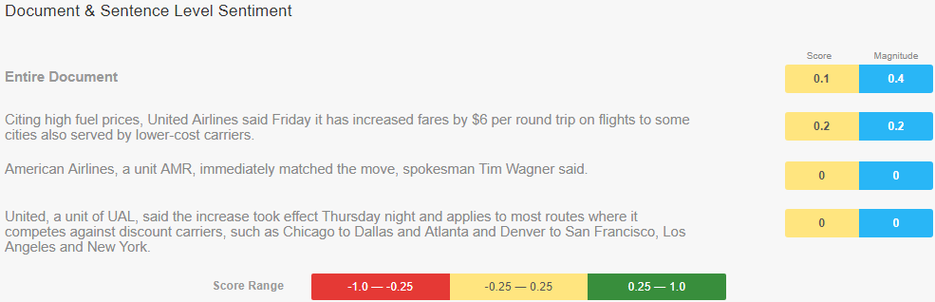
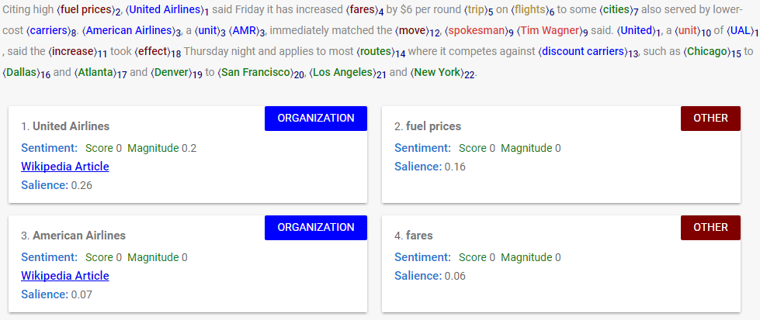

Cloud Natural Language API
Cloud Natural Language API demo- https://cloud.google.com/natural-language/
extract Named Entities, labels Other for MISC,
extract sentiment of the text at document level, sentence level, entity level with score
Extract Syntax, categories and more
Document and sentence level sentiment with score and score range
Entities with sentiment, wiki data (if available)
Categories

Slide 9
Observations
For analysis purpose used same text and same url.
Stanford NLP for IE | IBM Watson for IE | Google Cloud Natural Language API
Supported | Supported along with entity level sentiment score | Supported with entity level sentiment score
Cannot extract useful information | Supported | Cannot extract useful information Consider it as entity ‘Other’
No predefined Categories | Has predefined categories | Has predefined categories(approx. 700+)
Sentiment, POS, Lemma, Dependency parse | Sentiment, emotion, keyword, category, semantic roles, concept | Sentiment, syntax, category
Support Multi-Lang(Eng, Japanese) | Doesn’t Support Multi-lang | Support Multi-Lang(almost all)
Named entity Recognition
URL
Categories
Others
Multi-Lang

Slide 10
References:
https://www.quora.com/search?q=what+is+information+extraction
https://web.stanford.edu/class/cs124/lec/Information_Extraction_and_Named_Entity_Recognition.pdf
https://www.ibm.com/support/knowledgecenter/en/SSEPGG_9.5.0/com.ibm.datatools.datamining.doc/c_ta_information_extraction.html
https://cloud.google.com/natural-language/
Text Analysis demo
http://corenlp.run/
https://natural-language-understanding-demo.ng.bluemix.net/
https://cloud.google.com/natural-language/
Thank You

